Slide 1
Lasers and Waves

Slide 2
Waves

Slide 3
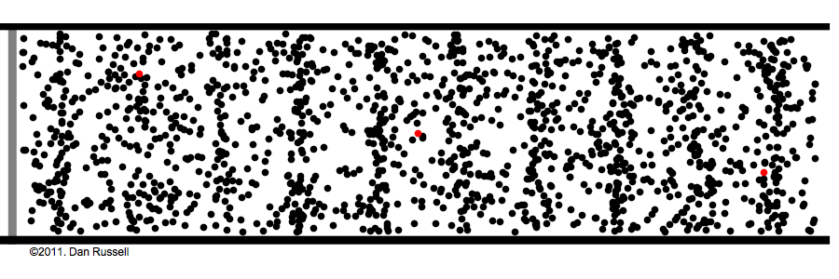
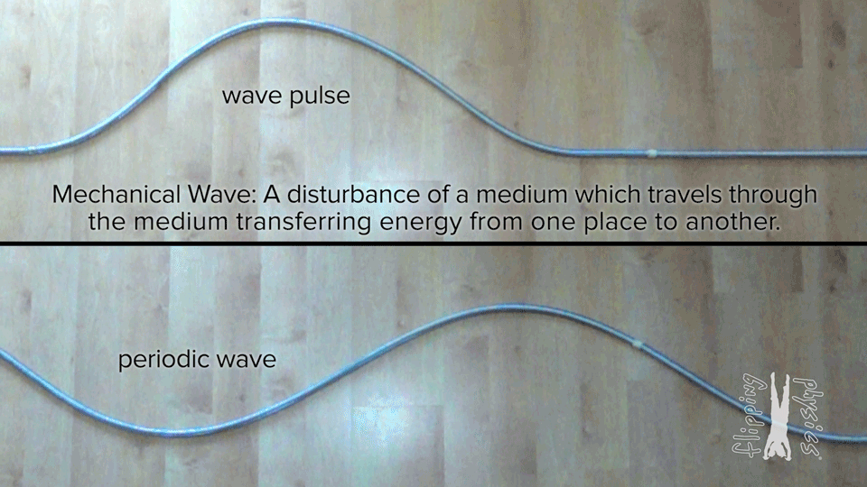
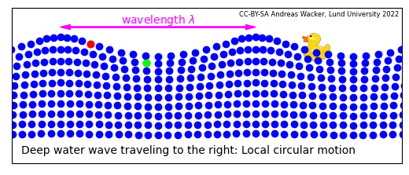
Oscillations
Waves are oscillations of particles or energy.

Slide 4
Demo: Tub of Water

Slide 5
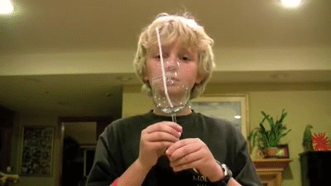
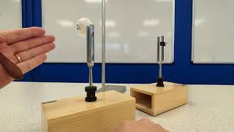
Resonance
Materials are created from vibrating atoms. If you can match the frequency of those vibrations, you have resonance!

Slide 6
Demo: Household Objects

Slide 7
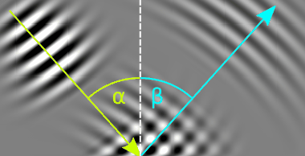
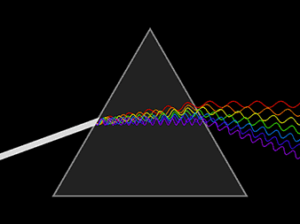
Reflection and Refraction
Waves, like particles, can bounce off of objects. This bouncing is called reflection.
Unlike particles, waves bend their paths when entering new medium. This is called refraction.

Slide 8
Demo: Rainbow

Slide 9
Quantum Mechanics

Slide 10
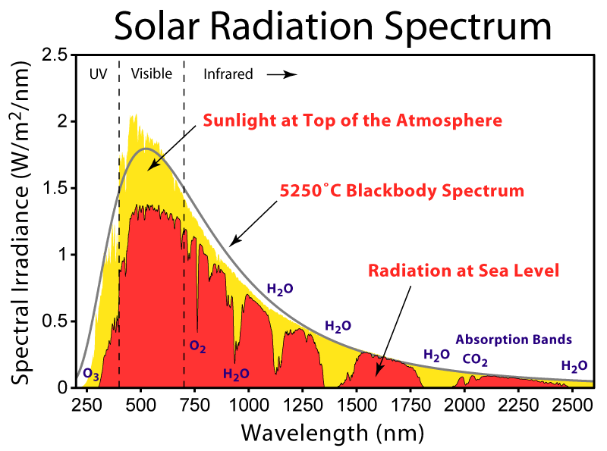
Blackbodies
If you shine a light on any object, they can either absorb, reflect, or transmit that light.
Blackbodies are only allowed to absorb and re-emit light.
They pretty accurately model celestial radiation, even for our sun!

Slide 11
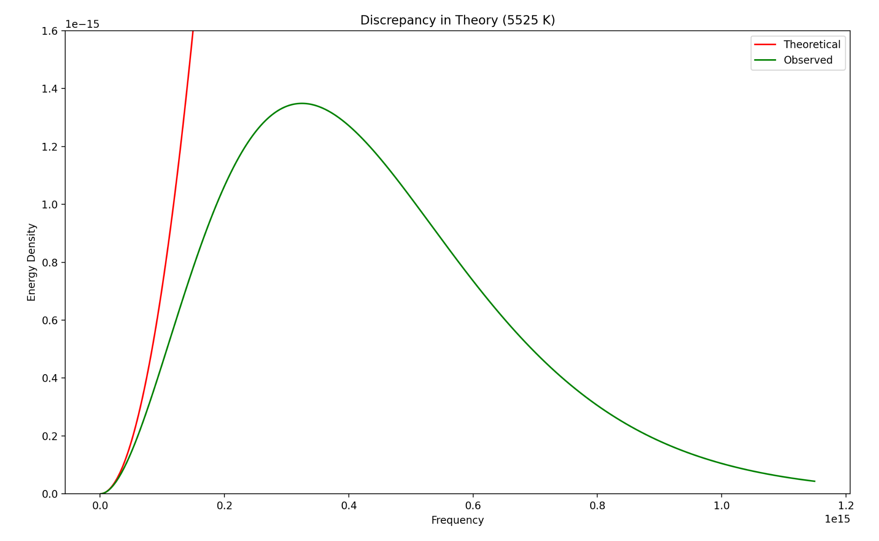
Blackbody Energy
A blackbody gains energy by absorbing light of different frequencies.
How much of the energy is due to light of a specific frequency?
Lord Rayleigh, and later Jeans, came up with an expression that works well for low frequency emissions.
Why does it fail for higher frequencies?

Slide 12
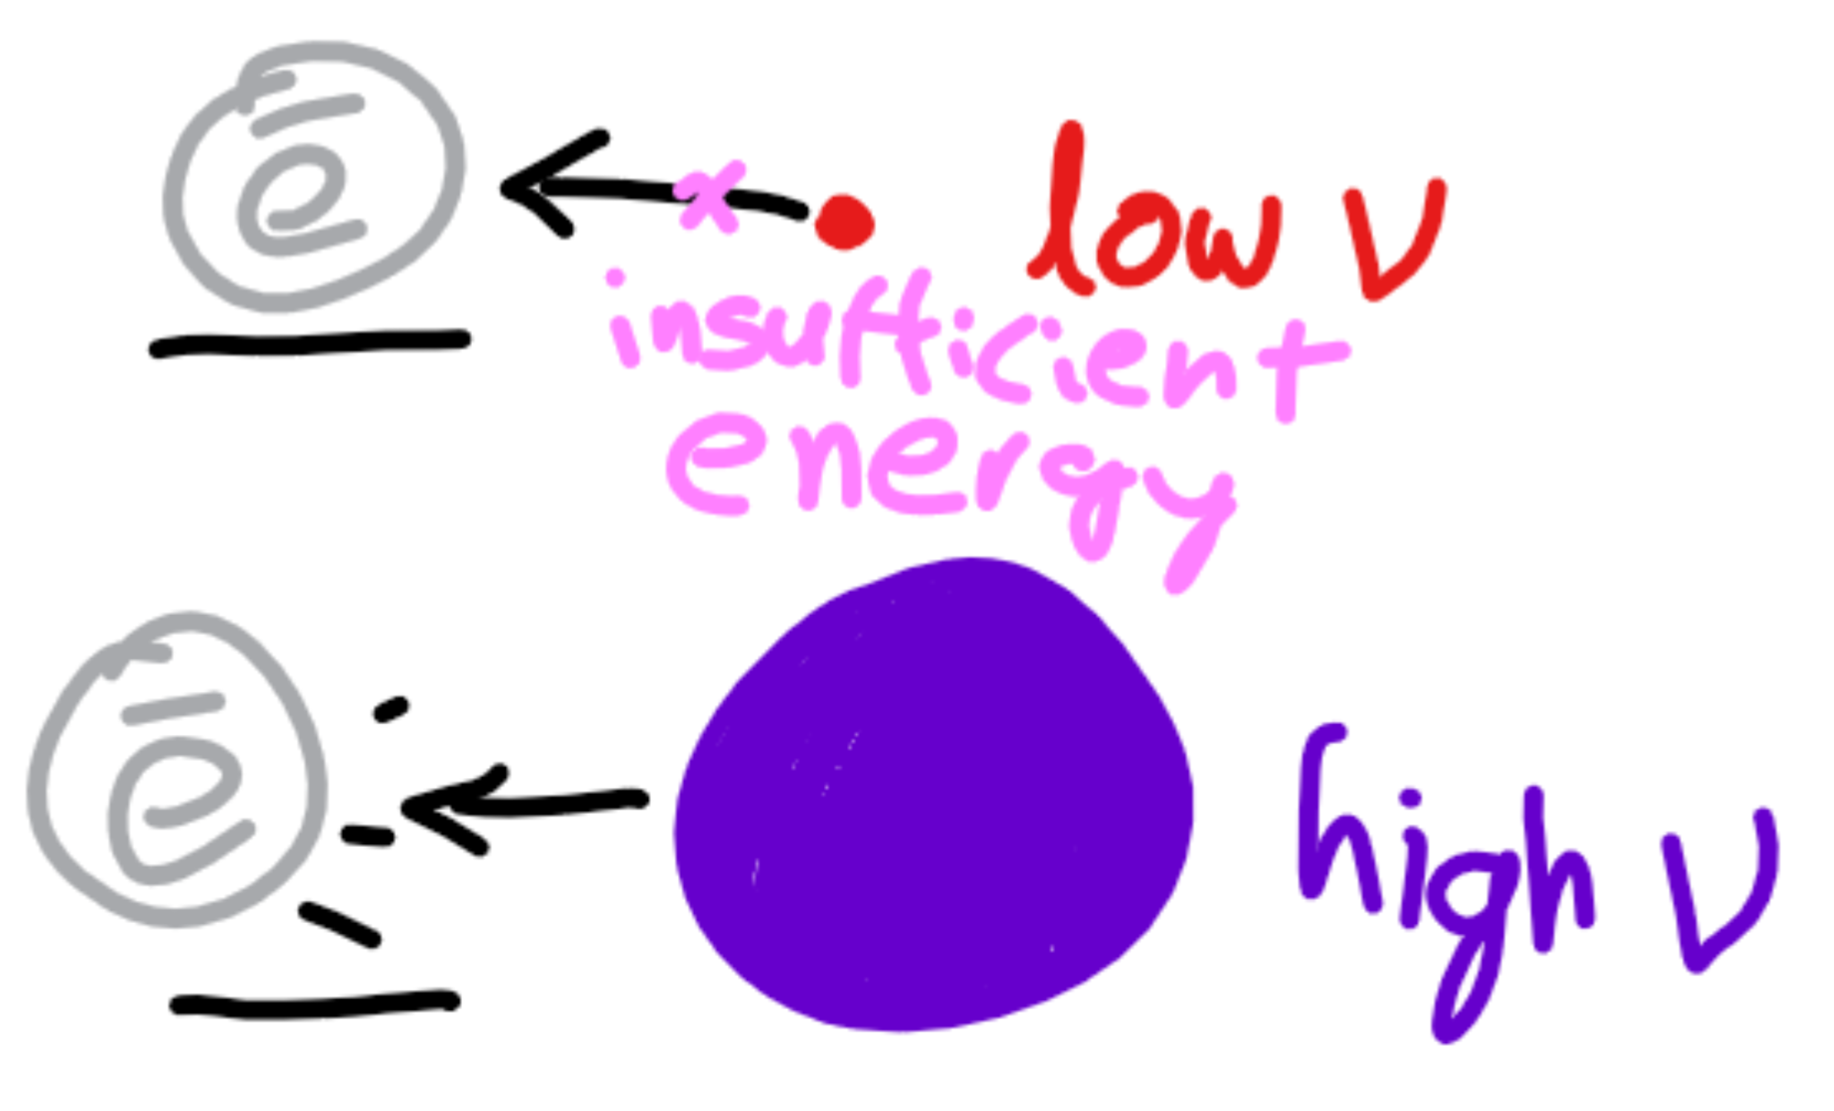
Photoelectric Effect
For decades, people have been using light to blast electrons off of metals.
They noticed higher frequency lights had more success in removing these electrons.
This led to the theory that light was made of particles (photons) whose individual energies were proportional to the frequency of the light.

Slide 13
Demo: Tinsel on a Can

Slide 14
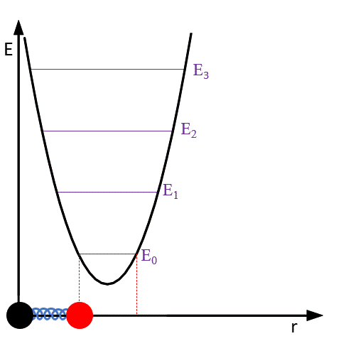
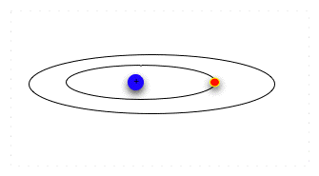
Energy Levels
Atoms have discrete energy levels. This means we can count them: 0, 1, 2, 3, etc.
It takes energy to travel to a higher energy level, while travelling to a lower energy level releases energy.

Slide 15
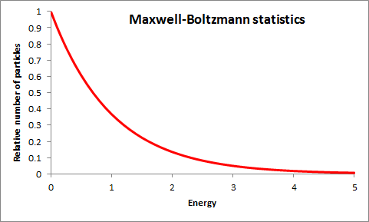
Boltzmann Distribution
Objects want to be in lower energy levels. Boltzmann discovered that the probability of being in a higher energy level is exponentially lower than being in a lower one.

Slide 16
Demo: Coconuts and Castaways

Slide 17
Optics

Slide 18
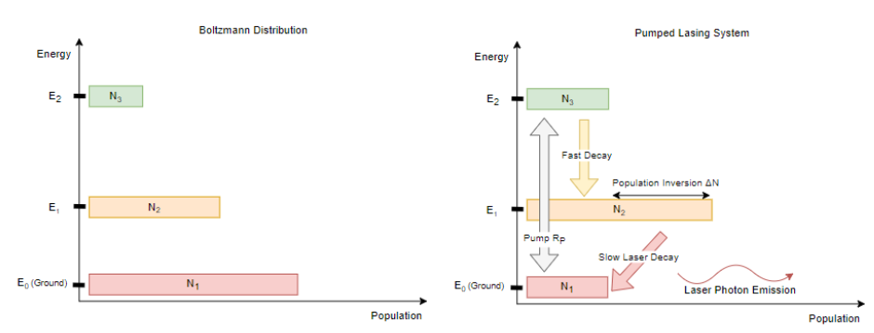
Lasers
Early lasers were created by using population inversion. This is where you excite an atom so the higher energy levels are more likely.

Slide 19
Demo: Diffraction

Slide 20

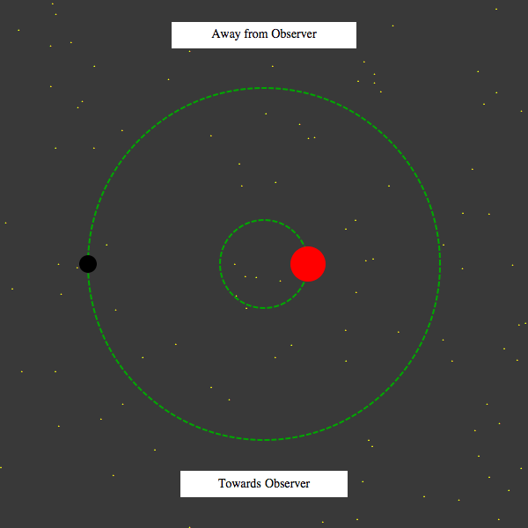
Doppler Effect
Sound travelling away from us becomes lower in pitch, this is called the Doppler effect.
Light travelling away from us becomes lower in energy (redder), this is called redshift.

Slide 21
Applications

Slide 22
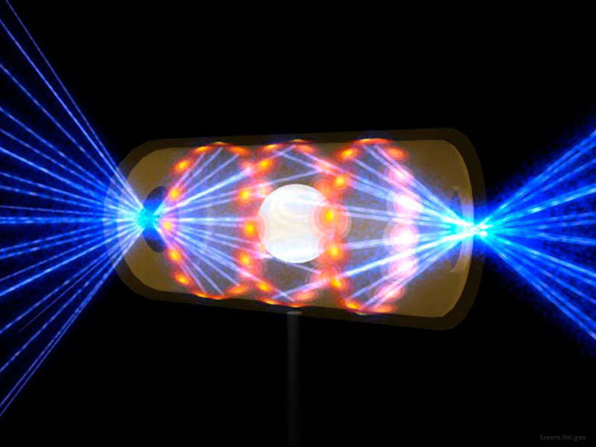
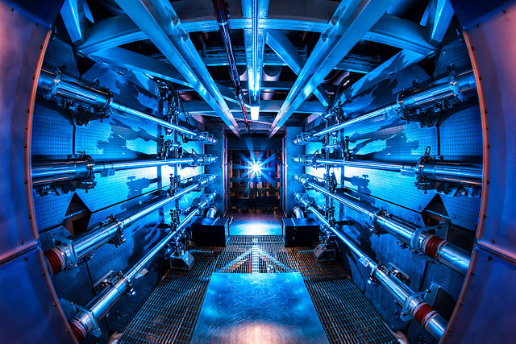
Inertial Confinement Fusion

Slide 23
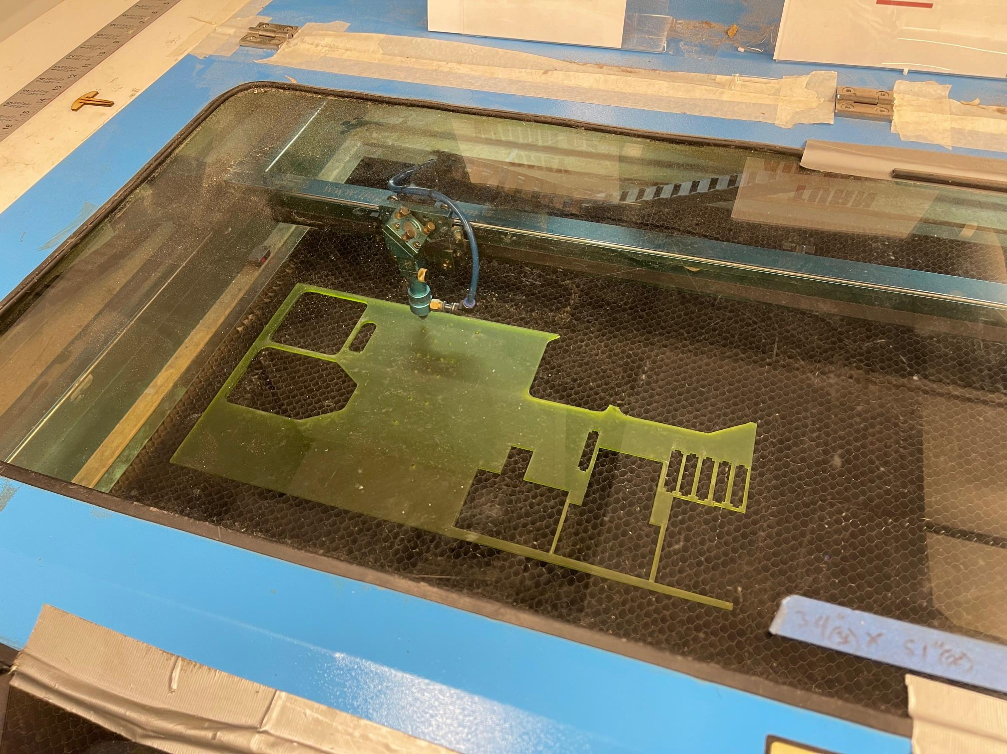
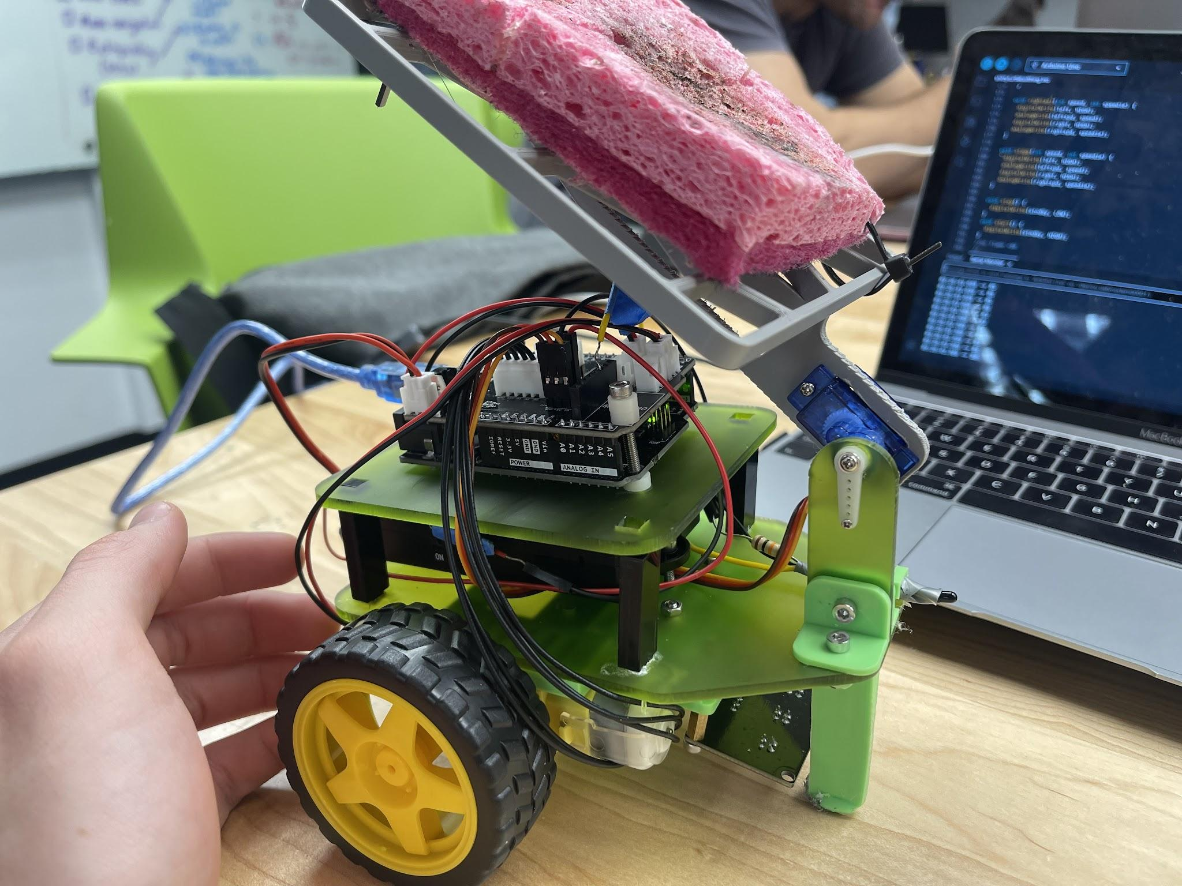
Laser Cutting

Slide 24
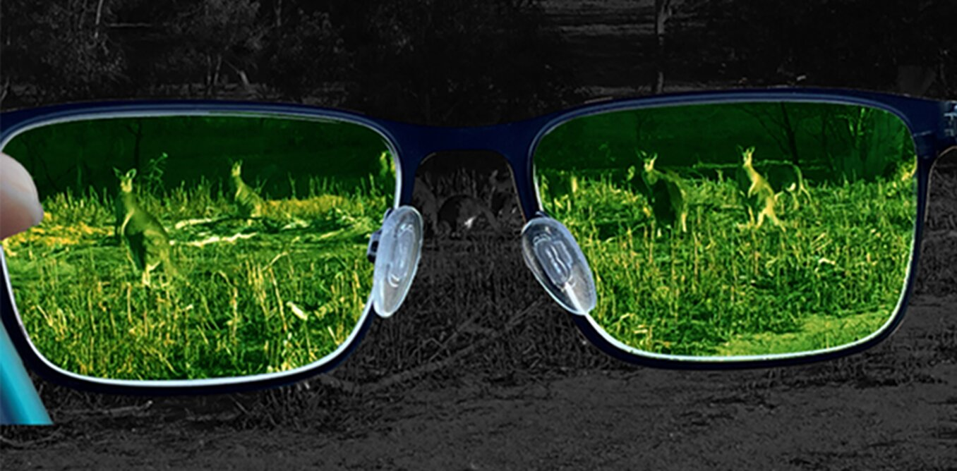
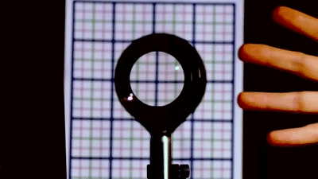
Nonlinear Optics

